Slide 1
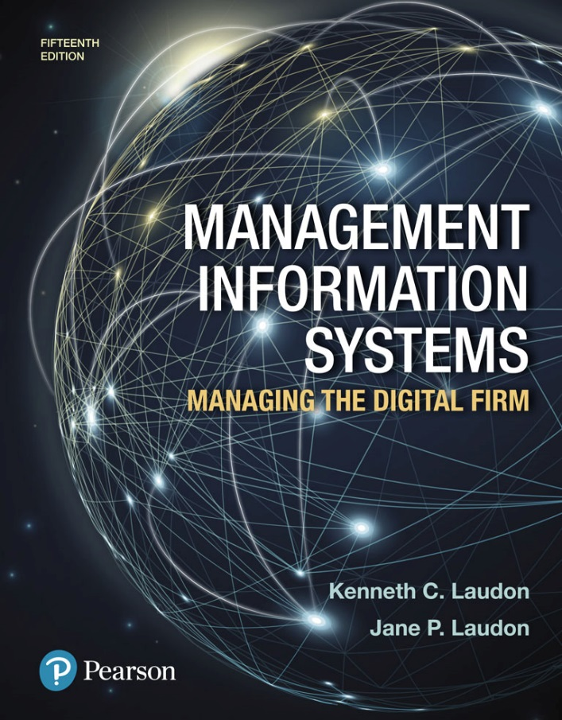
Management Information Systems: Managing the Digital Firm
Fifteenth edition
Chapter 8
Securing Information Systems

Slide 2
Why Systems Are Vulnerable (1 of 2)
Security
  Policies, procedures, and technical measures used to prevent unauthorized access, alteration, theft, or physical damage to information systems
Controls
  Methods, policies, and organizational procedures that ensure safety of organization’s assets; accuracy and reliability of its accounting records; and operational adherence to management standards

Slide 3
Why Systems Are Vulnerable (2 of 2)
Accessibility of networks
Hardware problems (breakdowns, configuration errors, damage from improper use or crime)
Software problems (programming errors, installation errors, unauthorized changes)
Disasters
Use of networks/computers outside of firm’s control
Loss and theft of portable devices

Slide 4
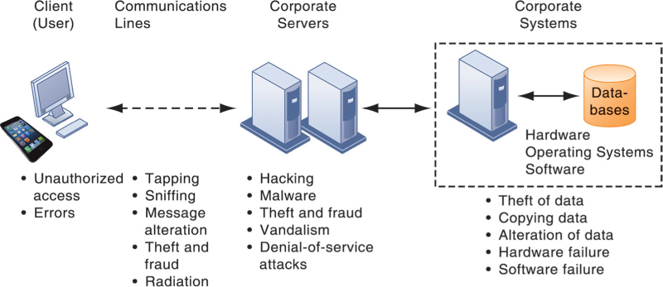
Figure 8.1: Contemporary Security Challenges and Vulnerabilities

Slide 5
Internet Vulnerabilities
Network open to anyone
Size of Internet means abuses can have wide impact
Use of fixed Internet addresses with cable / DSL modems creates fixed targets for hackers
Unencrypted VOIP
E-mail, P2P, IM
  Interception
  Attachments with malicious software
  Transmitting trade secrets

Slide 6
Wireless Security Challenges
Radio frequency bands easy to scan
SSIDs (service set identifiers)
  Identify access points, broadcast multiple times, can be identified by sniffer programs
War driving
  Eavesdroppers drive by buildings and try to detect SSID and gain access to network and resources
  Once access point is breached, intruder can gain access to networked drives and files
Rogue access points

Slide 7
Malicious Software: Viruses, Worms, Trojan Horses, and Spyware (1 of 2)
Malware (malicious software)
Viruses
Worms
Worms and viruses spread by
  Downloads and drive-by downloads
  E-mail, IM attachments
Mobile device malware
Social network malware

Slide 8
Malicious Software: Viruses, Worms, Trojan Horses, and Spyware (2 of 2)
Trojan horse
SQL injection attacks
Ransomware
Spyware
  Key loggers
  Other types
    Reset browser home page
    Redirect search requests
    Slow computer performance by taking up memory

Slide 9
Hackers and Computer Crime (1 of 3)
Hackers vs. crackers
Activities include:
  System intrusion
  System damage
  Cybervandalism
    Intentional disruption, defacement, destruction of website or corporate information system
Spoofing and sniffing

Slide 10
Hackers and Computer Crime (2 of 3)
Denial-of-service attacks (DoS)
Distributed denial-of-service attacks (DDoS)
Botnets
Spam
Computer crime
  Computer may be target of crime
  Computer may be instrument of crime

Slide 11
Hackers and Computer Crime (3 of 3)
Identity theft
  Phishing
  Evil twins
  Pharming
Click fraud
Cyberterrorism
Cyberwarfare

Slide 12
Internal Threats: Employees
Security threats often originate inside an organization
Inside knowledge
Sloppy security procedures
  User lack of knowledge
Social engineering
Both end users and information systems specialists are sources of risk

Slide 13
Software Vulnerability
Commercial software contains flaws that create security vulnerabilities
  Bugs (program code defects)
  Zero defects cannot be achieved because complete testing is not possible with large programs
  Flaws can open networks to intruders
Patches
  Small pieces of software to repair flaws
  Exploits often created faster than patches can be released and implemented

Slide 14
What Is the Business Value of Security and Control?
Failed computer systems can lead to significant or total loss of business function
Firms now are more vulnerable than ever
  Confidential personal and financial data
  Trade secrets, new products, strategies
A security breach may cut into a firm’s market value almost immediately
Inadequate security and controls also bring forth issues of liability

Slide 15
Legal and Regulatory Requirements for Electronic Records Management
HIPAA
  Medical security and privacy rules and procedures
Gramm-Leach-Bliley Act
  Requires financial institutions to ensure the security and confidentiality of customer data
Sarbanes-Oxley Act
  Imposes responsibility on companies and their management to safeguard the accuracy and integrity of financial information that is used internally and released externally

Slide 16
Electronic Evidence and Computer Forensics
Electronic evidence
  Evidence for white collar crimes often in digital form
  Proper control of data can save time and money when responding to legal discovery request
Computer forensics
  Scientific collection, examination, authentication, preservation, and analysis of data from computer storage media for use as evidence in court of law
  Recovery of ambient data

Slide 17
Information Systems Controls
May be automated or manual
General controls
  Govern design, security, and use of computer programs and security of data files in general throughout organization
  Software controls, hardware controls, computer operations controls, data security controls, system development controls, administrative controls,
Application controls
  Controls unique to each computerized application
  Input controls, processing controls, output controls

Slide 18
Risk Assessment
Determines level of risk to firm if specific activity or process is not properly controlled
    Types of threat
    Probability of occurrence during year
    Potential losses, value of threat
    Expected annual loss

Slide 19
Table 8.5 Online Order Processing Risk Assessment
EXPOSURE | PROBABILITY OF OCCURRENCE | LOSS RANGE (AVERAGE) ($) | EXPECTED ANNUAL LOSS ($)
Power failure | 30% | $5,000 - $200,000 ($102,500) | $30,750
Embezzlement | 5% | $1,000 - $50,000 ($25,500) | $1275
User error | 98% | $200 - $40,000 ($20,100) | $19,698

Slide 20
Security Policy
Ranks information risks, identifies acceptable security goals, and identifies mechanisms for achieving these goals
Drives other policies
  Acceptable use policy (AUP)
    Defines acceptable uses of firm’s information resources and computing equipment
Identity management
  Identifying valid users
  Controlling access

Slide 21
Disaster Recovery Planning and Business Continuity Planning
Disaster recovery planning
  Devises plans for restoration of disrupted services
Business continuity planning
  Focuses on restoring business operations after disaster
Both types of plans needed to identify firm’s most critical systems
  Business impact analysis to determine impact of an outage
  Management must determine which systems restored first

Slide 22
The Role of Auditing
Information systems audit
  Examines firm’s overall security environment as well as controls governing individual information systems
Security audits
  Review technologies, procedures, documentation, training, and personnel
  May even simulate disaster to test responses
List and rank control weaknesses and the probability of occurrence
Assess financial and organizational impact of each threat

Slide 23
What Are the Most Important Tools and Technologies for Safeguarding Information Systems? (1 of 3)
Identity management software
  Automates keeping track of all users and privileges
  Authenticates users, protecting identities, controlling access
Authentication
  Password systems
  Tokens
  Smart cards
  Biometric authentication
  Two-factor authentication

Slide 24
What Are the Most Important Tools and Technologies for Safeguarding Information Systems? (2 of 3)
Firewall
  Combination of hardware and software that prevents unauthorized users from accessing private networks
  Technologies include:
    Packet filtering
    Stateful inspection
    Network address translation (NAT)
    Application proxy filtering

Slide 25
What Are the Most Important Tools and Technologies for Safeguarding Information Systems? (3 of 3)
Intrusion detection system
  Monitors hot spots on corporate networks to detect and deter intruders
Antivirus and antispyware software
  Checks computers for presence of malware and can often eliminate it as well
  Requires continual updating
Unified threat management (UTM) systems

Slide 26
Encryption and Public Key Infrastructure (1 of 3)
Encryption
  Transforming text or data into cipher text that cannot be read by unintended recipients
  Two methods for encryption on networks
    Secure Sockets Layer (SSL) and successor Transport Layer Security (TLS)
    Secure Hypertext Transfer Protocol (S-HTTP)

Slide 27
Encryption and Public Key Infrastructure (2 of 3)
Two methods of encryption
  Symmetric key encryption
    Sender and receiver use single, shared key
  Public key encryption
    Uses two, mathematically related keys: public key and private key
    Sender encrypts message with recipient’s public key
    Recipient decrypts with private key

Slide 28
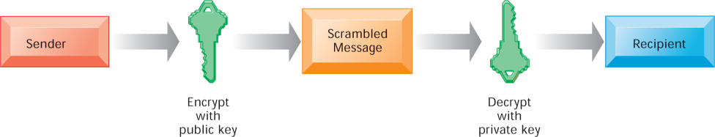
Figure 8.6: Public Key Encryption

Slide 29
Encryption and Public Key Infrastructure (3 of 3)
Digital certificate
  Data file used to establish the identity of users and electronic assets for protection of online transactions
  Uses a trusted third party, certification authority (CA), to validate a user's identity
  CA verifies user’s identity, stores information in CA server, which generates encrypted digital certificate containing owner ID information and copy of owner’s public key
Public key infrastructure (PKI)
  Use of public key cryptography working with certificate authority
  Widely used in e-commerce

Slide 30
Ensuring System Availability
Online transaction processing requires 100% availability
Fault-tolerant computer systems
  Contain redundant hardware, software, and power supply components that create an environment that provides continuous, uninterrupted service
Deep packet inspection
Security outsourcing
  Managed security service providers (MSSPs)

Slide 31
Security Issues for Cloud Computing and the Mobile Digital Platform (1 of 2)
Security in the cloud
  Responsibility for security resides with company owning the data
  Firms must ensure providers provide adequate protection:
    Where data are stored
    Meeting corporate requirements, legal privacy laws
    Segregation of data from other clients
    Audits and security certifications
  Service level agreements (SLAs)

Slide 32
Security Issues for Cloud Computing and the Mobile Digital Platform (2 of 2)
Securing mobile platforms
  Security policies should include and cover any special requirements for mobile devices
    Guidelines for use of platforms and applications
  Mobile device management tools
    Authorization
    Inventory records
    Control updates
    Lock down/erase lost devices
    Encryption
  Software for segregating corporate data on devices

Slide 33
Ensuring Software Quality
Software metrics: Objective assessments of system in form of quantified measurements
  Number of transactions
  Online response time
  Payroll checks printed per hour
  Known bugs per hundred lines of code
Early and regular testing
Walkthrough: Review of specification or design document by small group of qualified people
Debugging: Process by which errors are eliminated

Slide 34
End

